Slide 1
Lecture 20
Multimedia

Slide 2
What is Multimedia?
Derived from the word “Multi” and “Media”
Multi
Many, Multiple,
Media
Tools that is used to represent or do a certain things, delivery medium, a form of mass communication – newspaper, magazine / tv.
Distribution tool & information presentation – text, graphic, voice, images, music and etc.

Slide 3
Definition of Multimedia
Multimedia is a combination of text, graphic, sound, animation, and video that is delivered interactively to the user by electronic or digitally manipulated means.
GRAPHIC
TEXT
MULTIMEDIA
VIDEO
AUDIO
ANIMATION

Slide 4
The Term “Media”
Can be categorized based on a few criteria:
Perception media
Representation media
Presentation media
Storage media
Transmission media

Slide 5
Perception Media
“How do humans perceive information”
We perceive information from what we see and what we hear
Visual media:
Text, graphics, images, video
Auditory media:
Music, sound and voice

Slide 6
Representation Media
“How is information encoded in the computer”
Referring to how the information is represented internally to the computer.
The encoding used is of essential importance.
Several options:
Text is encoded in ASCII
An audio data stream in PCM (Pulse Coded Modulation)
Image in JPEG format
Video in MPEG format

Slide 7
Presentation Media
“Which medium is used to output information from the computer or input in the computer”
Refers to physical means used by systems to reproduce information for humans, e.g: audio and visual devices
Input:
Keyboards, cameras, microphone, Head Mounted Device (for VR input)
Output:
Paper, monitors, loudspeakers

Slide 8
Storage Media
“Where is information stored”
Refer to various physical means for storing computer data, such as magnetic tapes, magnetic disks, or digital optical disks (CD-ROM, CD, DVD)

Slide 9
Transmission Media
“Which medium is used to transmit data”
Refers to the physical means – cable of various type (coaxial cable, twisted pair, fiber optics), radio tower, satellite – that allow the transmission of telecommunication signals.
The difference between transmission media and storage media is the capability of transferring data continuously over networked computers.

Slide 10
Elements of Multimedia
TEXT
GRAPHIC
TEXT
MULTIMEDIA
AUDIO
VIDEO
ANIMATION
A broad term for something that contains words to express something.
Text is the most basic element of multimedia.
A good choice of words could help convey the intended message to the users (keywords).
Used in contents, menus, navigational buttons

Slide 11
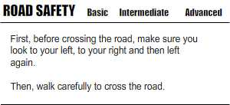
Elements of Multimedia
TEXT
GRAPHIC
TEXT
MULTIMEDIA
AUDIO
VIDEO
ANIMATION
Example

Slide 12
Elements of Multimedia
TEXT
GRAPHIC
GRAPHIC
MULTIMEDIA
AUDIO
VIDEO
ANIMATION
Two-dimensional figure or illustration
Could be produced manually (by drawing, painting, carving, etc.) or by computer graphics technology.
Used in multimedia to show more clearly what a particular information is all about (diagrams, picture).

Slide 13
Elements of Multimedia
TEXT
GRAPHIC
AUDIO
MULTIMEDIA
AUDIO
VIDEO
ANIMATION
Produced by vibration, as perceived by the sense of hearing.
In multimedia, audio could come in the form of speech, sound effects and also music score.

Slide 14
Elements of Multimedia
TEXT
GRAPHIC
ANIMATION
MULTIMEDIA
AUDIO
VIDEO
ANIMATION
The illusion of motion created by the consecutive display of images of static elements.
In multimedia, animation is used to further enhance / enriched the experience of the user to further understand the information conveyed to them.

Slide 15
Elements of Multimedia
TEXT
GRAPHIC
VIDEO
MULTIMEDIA
AUDIO
VIDEO
ANIMATION
Is the technology of capturing, recording, processing, transmitting, and reconstructing moving pictures.
Video is more towards photo realistic image sequence / live recording as in comparison to animation.
Video also takes a lot of storage space. So plan carefully before you are going to use it.

Slide 16
Interactive Multimedia
When the user is given the option of controlling the elements.
Hyper Media
A combination of hypertext, graphics, audio, video, (linked elements) and interactivity culminating in a complete, non-linear computer-based experience.

Slide 17
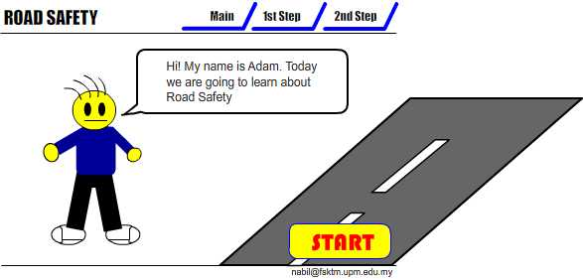
Example
Interactive Multimedia

Slide 18
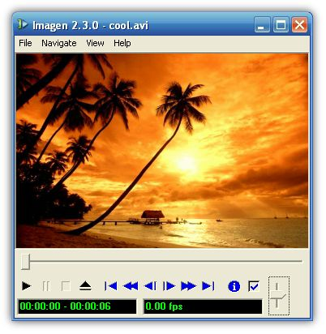


Example
Hyper Media
Main Page
Video link
Image link
Audio Link

Slide 19
Linear VS Non-Linear
LINEAR
A Multimedia Project is identified as Linear when:
It is not interactive
User have no control over the content that is being showed to them.
Example:
A movie
A non-interactive lecture / demo show

Slide 20
Linear VS Non-Linear
NON-LINEAR
A Multimedia Project is identified as Non-Linear when:
It is interactive
Users have control over the content that is being showed to them.
Users are given navigational control
Example:
Games
Courseware
Interactive CD

Slide 21
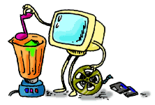
Authoring Tools
Use to merge multimedia elements (text, audio, graphic, animation, video) into a project.
Designed to manage individual multimedia elements and provide user interaction (if required).

Slide 22
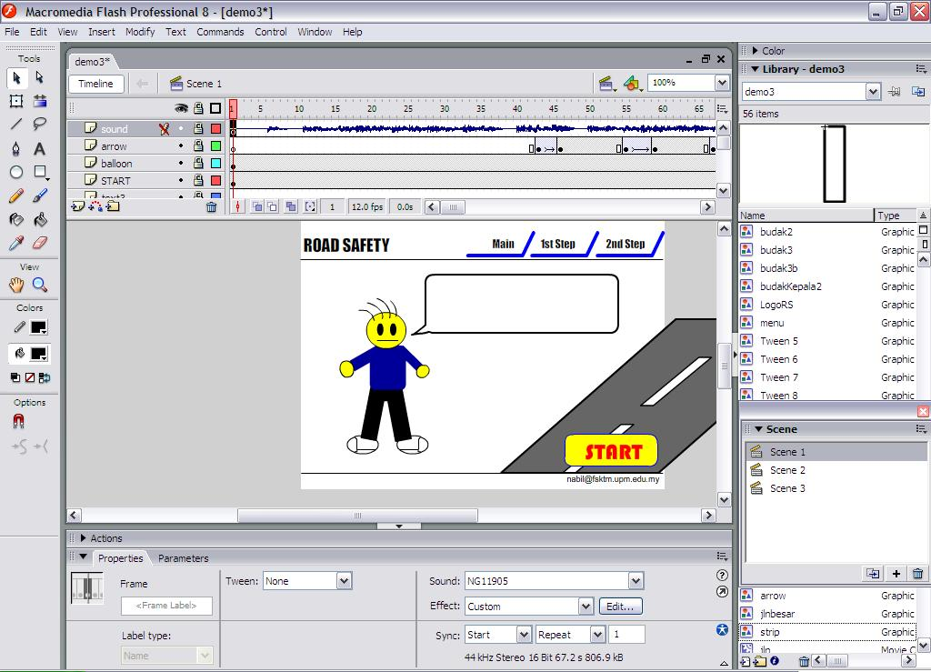
Authoring Tools
Example:
Macromedia Authorware
Macromedia Director
Macromedia Flash
Microsoft Power Point

Slide 23
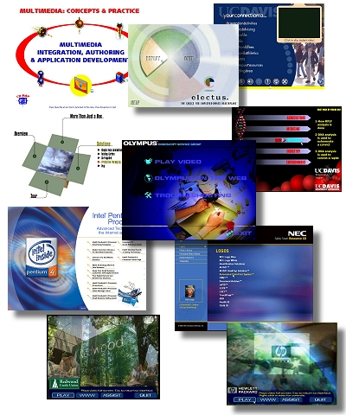
Importance of Multimedia
There are a number of fields where multimedia could be of use. Examples are:-
Business
Education
Entertainment
Home
Public Places

Slide 24
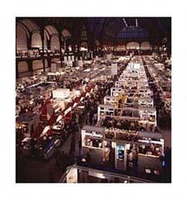
Importance of Multimedia
Business
Use and Applications
Sales / Marketing Presentation
Trade show production
Staff Training Application
Company Kiosk

Slide 25
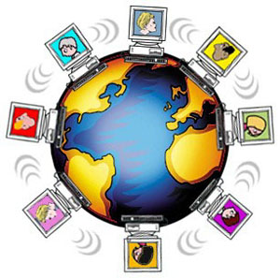
Importance of Multimedia
Education
Use and Applications
Courseware / Simulations
E-Learning / Distance Learning
Information Searching

Slide 26


Importance of Multimedia
Entertainment
Use and Applications
Games (Leisure / Educational)
Movies
Video on Demand
Online

Slide 27



Importance of Multimedia
Home
Use and Applications
Television
Satellite TV
SMS services (chats, voting, reality TV)

Slide 28

Importance of Multimedia
Public Places
Use and Applications
Smart Cards, Security

